Slide 1
CI MS Introduction
Common management tool in a diverse international network
23 May 2016 / Prague
Annamária Vrzáčková

Slide 2
Who we are?
49
23
3
Caritas shares the mission of the Catholic
Church to serve the poor and to promote
charity and justice throughout the world.
MONA
LACAR
16
Oceania
46
22
6
165 members
organisations
Notes:
Caritas Internationalis is confederation of over 160 members who are working at the grassroots in almost every country of the world. Caritas Internationalis has its headquarters in Rome – co-ordinating emergency operations, formulating development policy and advocating for a better world for everyone. All national Caritas organisations are members of their own regional Caritas networks (Europe, Asia, Africa, MONA, North Am, Latin America, Oceania) and the international confederation.

Slide 3
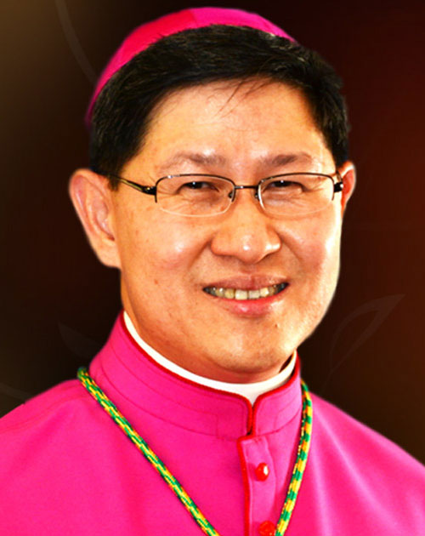
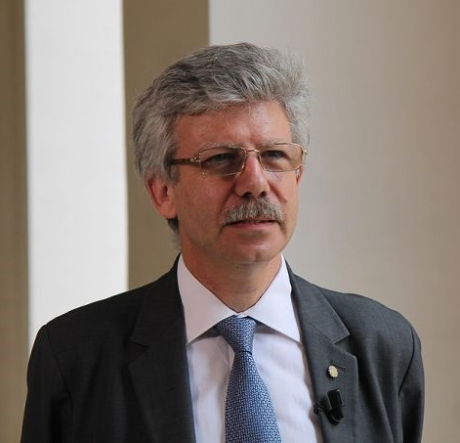
How Caritas Internationalis is structured?
Public juridical person of the Holy See
7 Regions
Governance (General Assembly) – every 4 yrs
President
Secretary General
Treasurer
General Secretariat
Member organisations are autonomous
Notes:
Holy See is an independent sovereign entity, it is responsible for the governance of all Catholics, organised in their Particular Churches, Patriarchates and religious institutes. Diplomatically, the Holy See acts and speaks for the whole church. The "Holy See" is not the same entity as the "Vatican City State“. The Vatican City State is the smallest state in the world by both area and population ruled by the Bishop of Rome – the Pope.
Our President The President is the global representative of Caritas Internationalis. The current incumbent is Cardinal Luis Antonio Gokim Tagle. He was elected President at the 20th General Assembly in May 2015.
Our Secretary General The Chief Executive Officer of Caritas Internationalis is Michel Roy. He was elected for a second term as Secretary General at the 20th General Assembly in May 2015.
Our Treasurer Alexander Bodmann is the treasurer of Caritas Internationalis. He was elected in May 2015.

Slide 4
Since 1999…
2014
CI Management Standards approved
2007 – 2009
To develop “transparency and quality standards”
1999
CI Common Financial Standards for Project Management
2010
“Capacity Building in Financial Management & Accountability” Program
2011
Developing the minimum standards as defined in the Internal Rules
2013
Developing the management standards thanks to Caritas Europa
Effective for all Member Organisations
as of 1st January 2015 (“ad experimentum”)

Slide 5
Why CI Management Standards?
Credit to: Godfrey Otwi Onentho
Notes:
CI MS effective for all Member Organisations as of 1st January 2015. Experimental phase: 2015 – 2018. Mos have to be assessed every 4 years.
The scope of the Management Standards derives from Internal Rule 1.3.: “Member Organisations must meet minimum standards of ① governance, ② organizational infrastructure, ③ financial viability and accountability and ④ compliance with ethical codes of conduct, as decided by the Representative Council. They remain autonomous in their juridical, financial and contractual status”.
From letter CI Secretary General to all MOs re: CI MS, 11 June 2014:
The CI Management Standards are a tool for each MO to check its own organisational ‘well-being’ and identify areas for improvement,
and to help MOs in their own institutional development.
In addition they serve as a point of reference for strengthening the Caritas confederation as a whole.

Slide 6
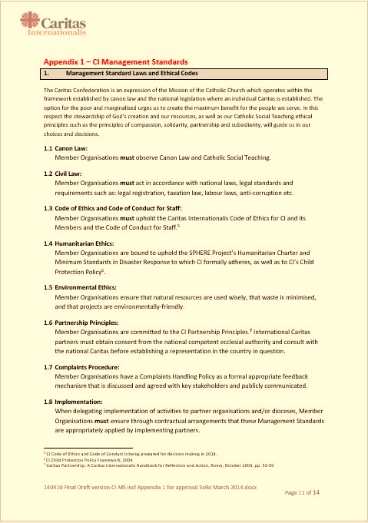
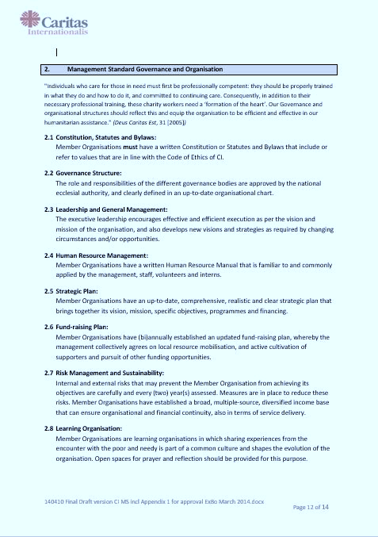
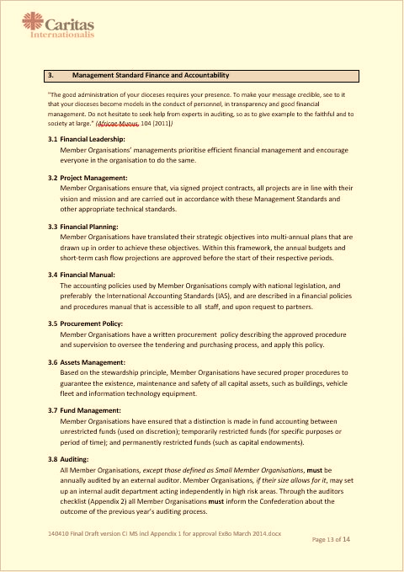
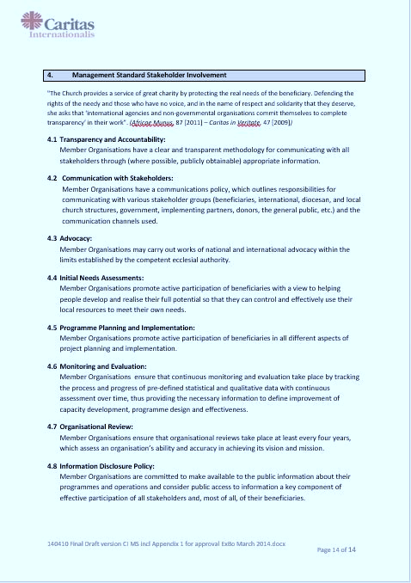
The standards and tools
CI Management Standards
Laws & Ethical Codes
Governance & Organisation
Finance & Accountability
Stakeholder Involvement
Tools
App.2: Auditors Checklist
App.3: Reporting form to MO Board & CI
App.4: (Self-)Assessment questionnaire
Notes:
The four Management Standards each consist of eight articles.

Slide 7
Initial steps before getting started...
Acknowledgement
letter
Notes:
Appoint CI MS Coordinator: as soon as possible
Acknowledge CI MS: as soon as possible (in any case before 31 December 2015)
Adopt / adapt Codes: 31 December 2015
Submitting documents for assessment: 30 June 2016
Optional:
Present candidate assessor(s)

Slide 8
Status (April, 2016)
REGIONS | CI MS Coordinator | Acknowledgement letter | Number of Assessors | CoE/CoC | Number of MO's
Africa | 37 | 33 | 33 | 9 | 46
Asia | 18 | 17 | 14 | 11 | 23
Europe | 44 | 34 | 11 | 20.5 | 49
LACAR | 22 | 22 | 6 | 22 | 22
MONA | 12 | 12 | 3 | 10 | 16
North America | 3 | 2 | 3 | 3 | 3
Oceania | 5 | 5 | 12 | 4 | 6
Total | 141 | 125 | 82 | 79.5 | 165
Notes:
Regional coordinators regularly receive a summary
Update Newsletter:
Where to send the adopted Codes?
Can a coordinator be an assessor too?
How to share best practices and where to send the documents?
What is the deadline for assessment and where to send the documentations?
The trainings that are organized for the CI MS coordinators and the assessors are also a platform that serves for clarifying questions that might come up in the implementation phase of the CI MS.
One of the most important successes was the Pope’s message on the CI MS that was distributed to all presidents, directors and coordinators. The message is as follows:
“As I said at your last General Assembly, I thank the Lord for Caritas and its valuable service in the world. I also congratulate the Governance bodies and the General Secretariat of Caritas Internationalis for developing and approving the Management Standards and Code of Conduct for the member organizations.
These instruments must now be applied to strengthen the transparency and credibility of Caritas. Let us remember that we are accountable to God, to the Church, to the donors and in particular, to the poor with whom the Lord indentifies Himself. By serving them with humility, dedication, self-denial and professionalism, we promote the Church’s mission of forming one human family, caring for creation.” (Pope Francis, 19 October 2015)

Slide 9
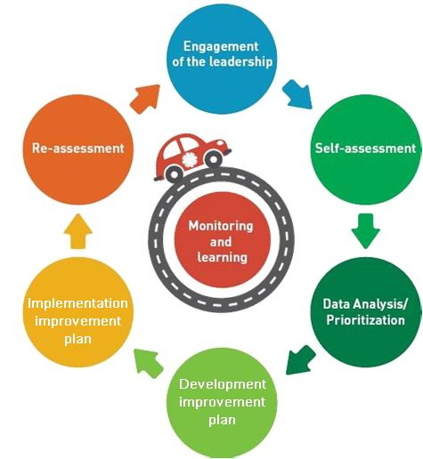
ID CS Cycle
Institutional Development focuses on the organisation
CI
ASSESSMENT
Capacity Strengthening focuses on
people.
Notes:
IDCS: Institutional Development and Capacity Strengthening aim is to strengthen Caritas organizations so they better achieve the mission rooted in faith and serve the people in an accountable manner. This is a deliberate process that improves the ability of an organization, network , group and individual to function effectively, work towards sustainability and achieve goals. IDCS encourages the organization to be risk-aware and forward thinking so that it anticipates and acts upon issues that might negatively affect the core mission and seizes new opportunities to strengthen the organization.
Institutional Development focuses on the organization. It seeks to enhance or develop the strategies, structures, systems, policies and processes needed to function effectively, work towards sustainability, and achieve goals. (For example establishing a new complaints procedure).
Capacity Strengthening focuses on people. It seeks to enhancing or developing new KSAs (knowledge, skills, attitudes) so individuals or teams are able to deliver the organization’s work and strive to meet its goals. (For example, training staff in financial management).
The engagement and commitment of the MOs’ governance towards making the changes needed to strengthen the organization are crucial for successful and sustainable IDCS. Active involvement of Church leadership in institutional development and capacity strengthening as well as their stimulation of continuous learning of their organisations contributes to the benefit of the people in need.

Slide 10
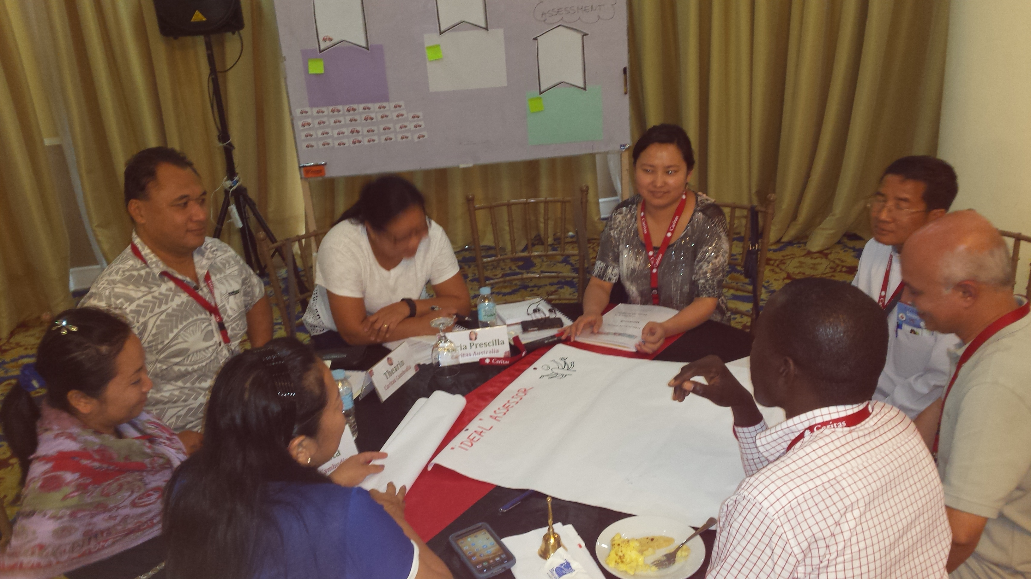
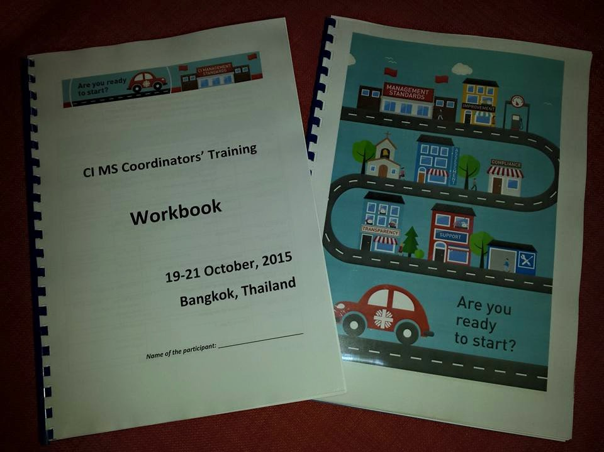
Tools: manuals
Self-assessment
Data Analysis and Prioritization
Improvement plan
Monitoring and Learning (to be developed)
External assessment
Manual for assessors to be developed
Notes:
Interactive methodology: working groups, case study, role plays
Tools: manual, workbook

Slide 11
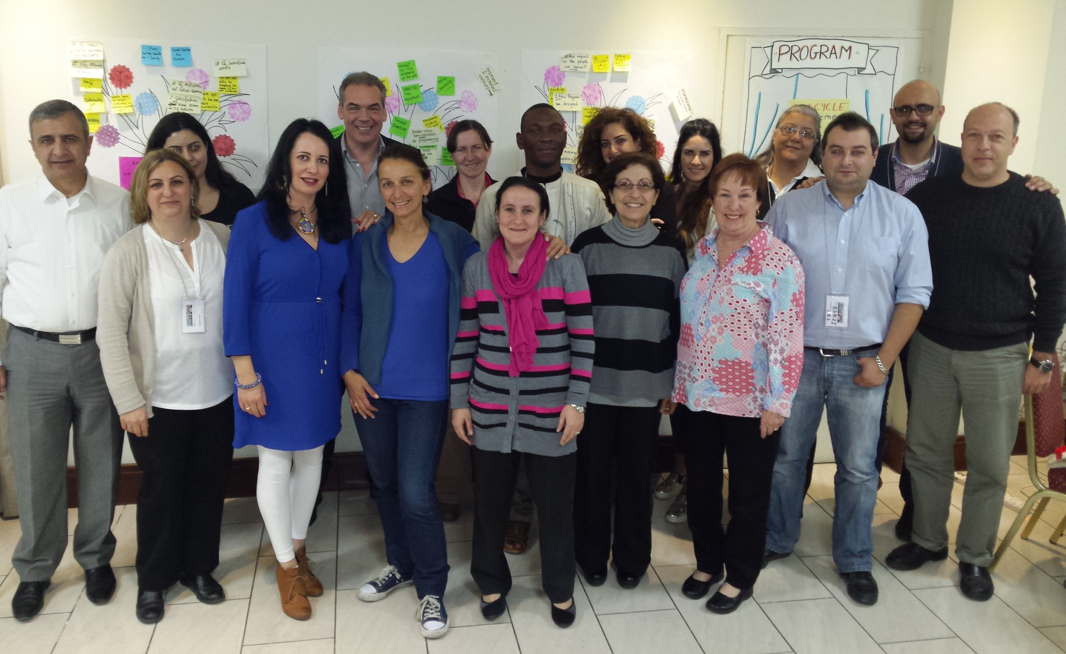
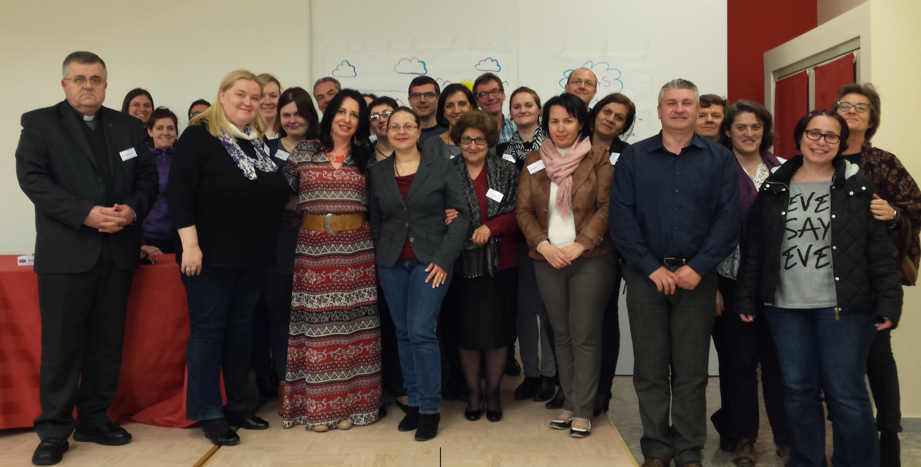
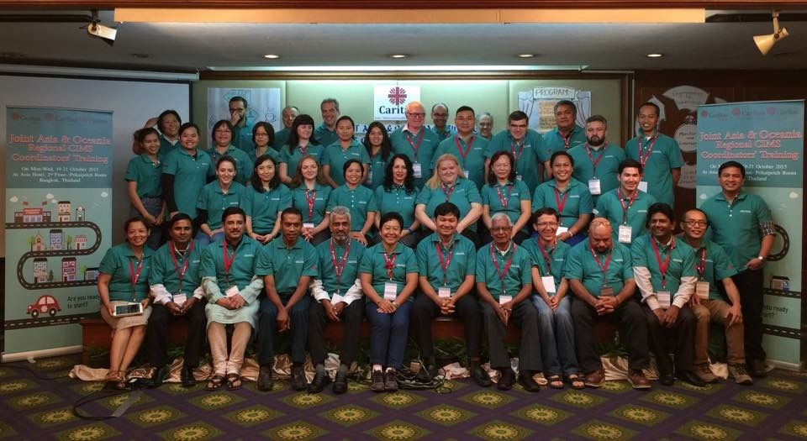
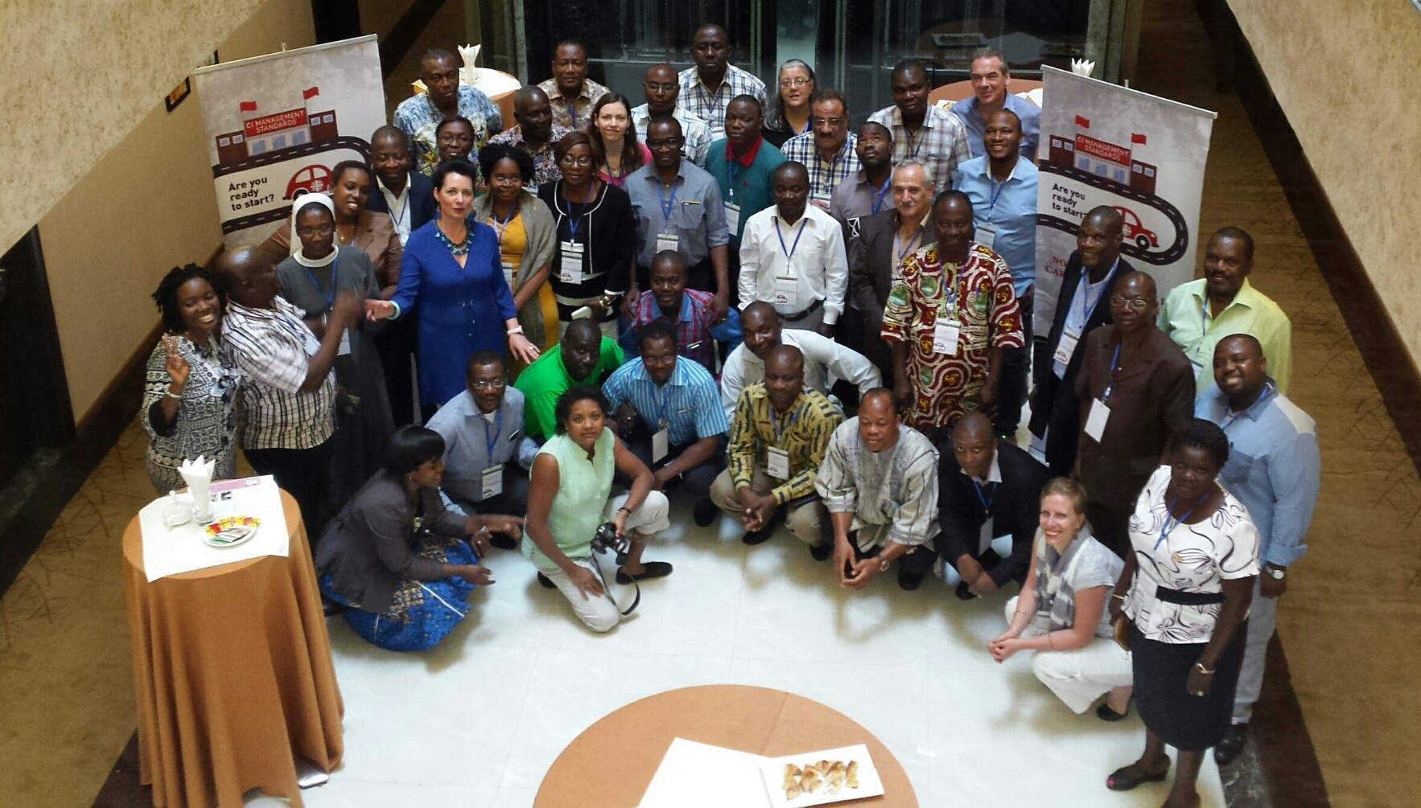
Training for coordinators

Slide 12
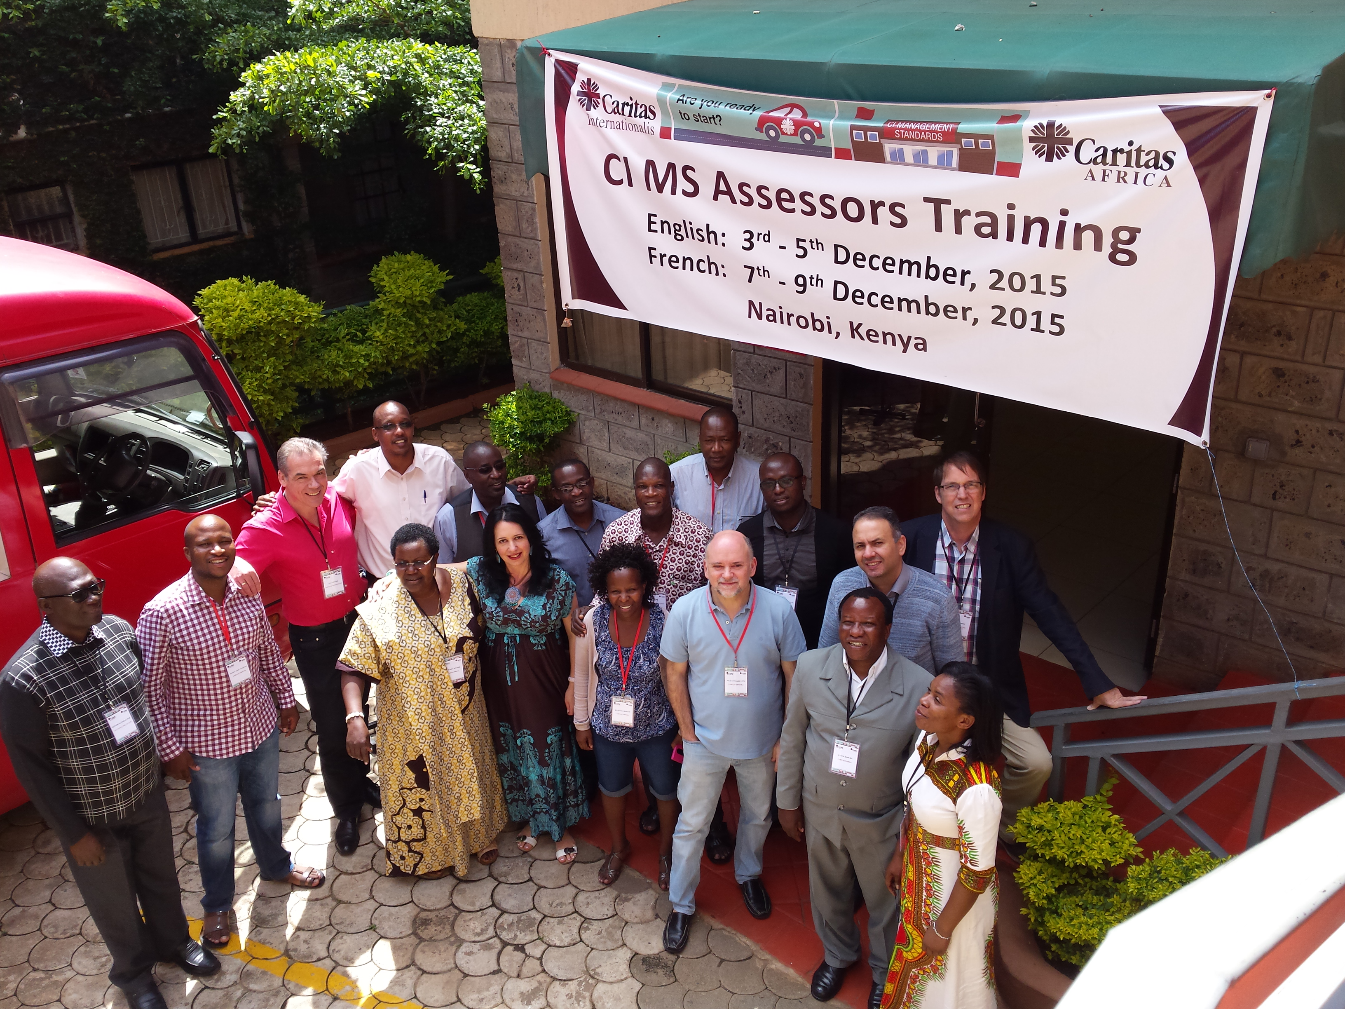
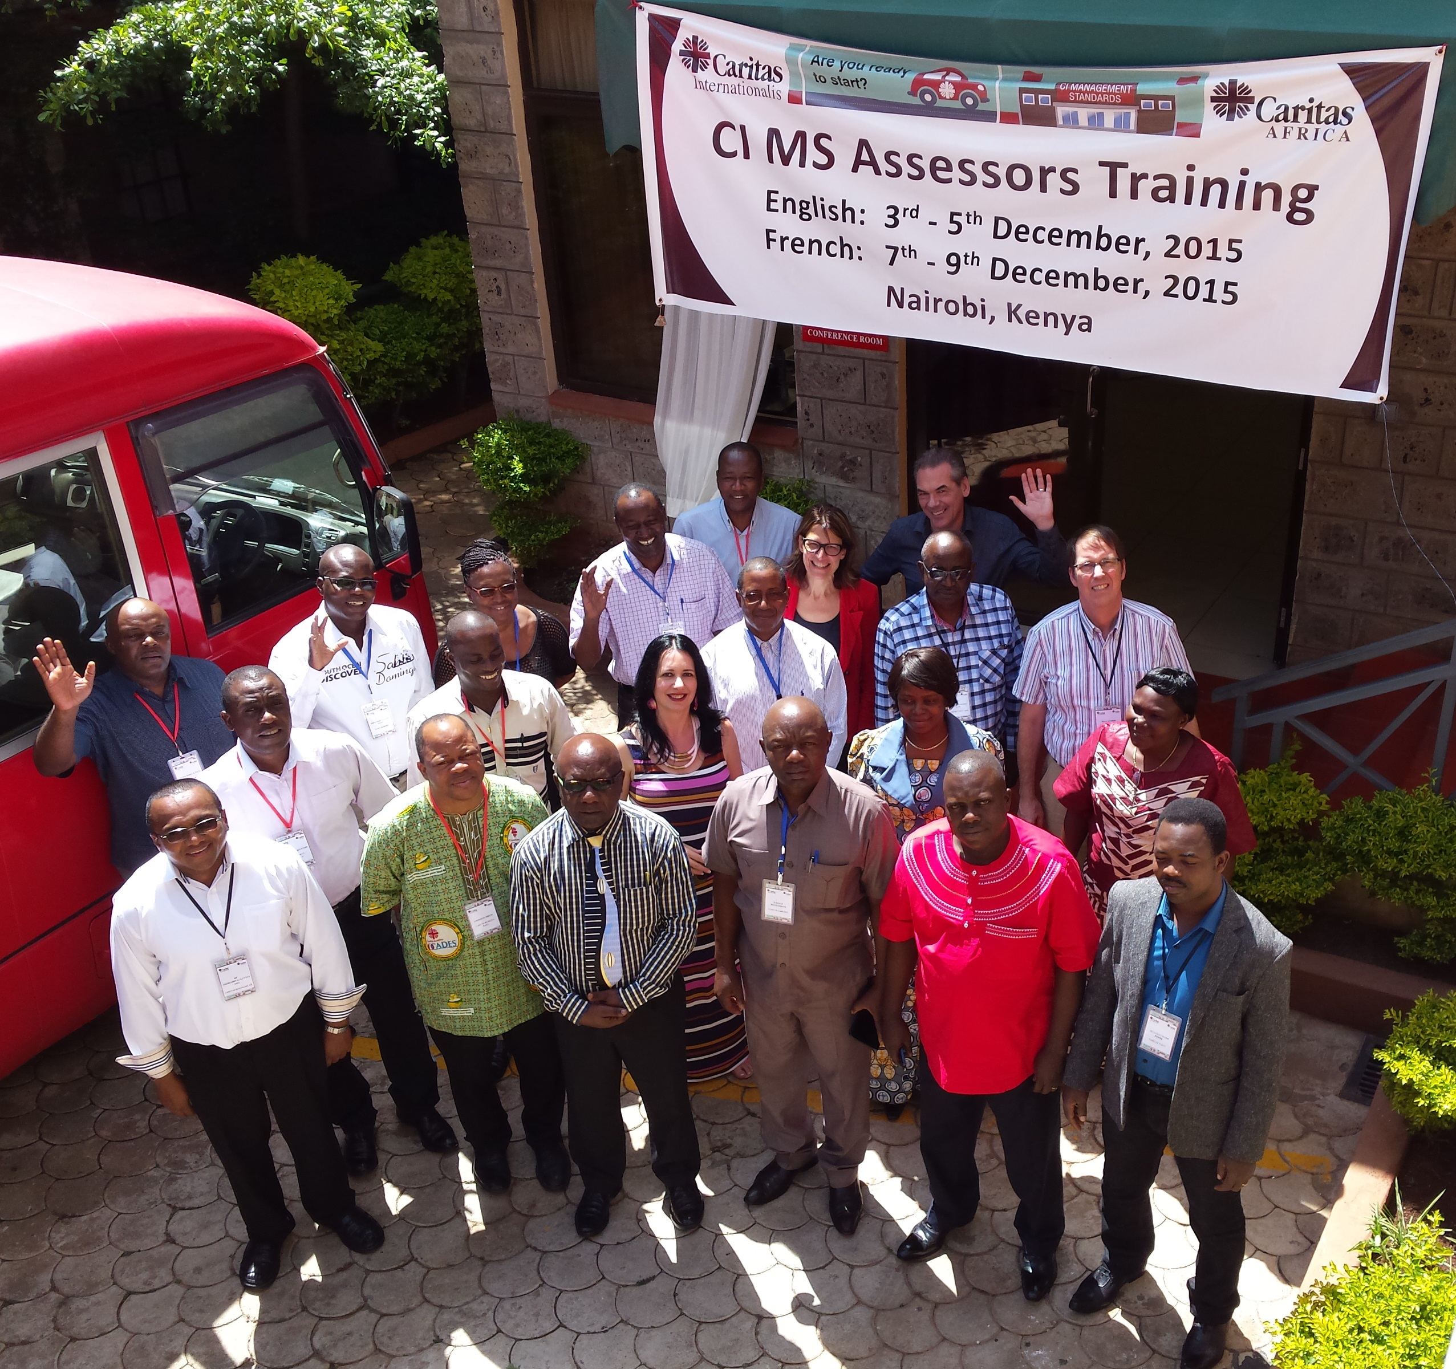
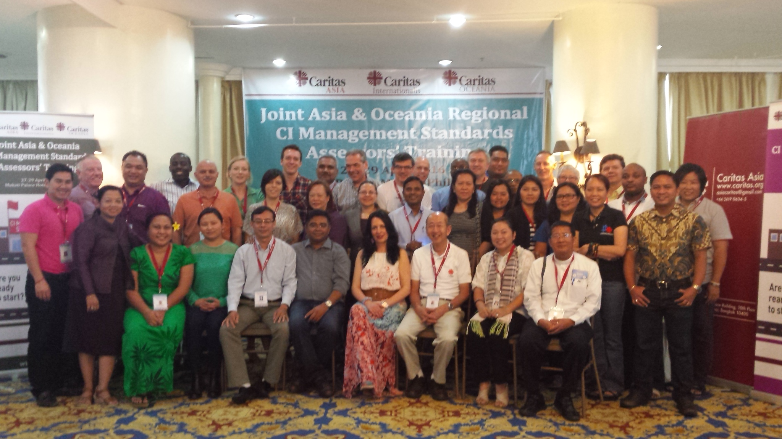
Training for assessors

Slide 13
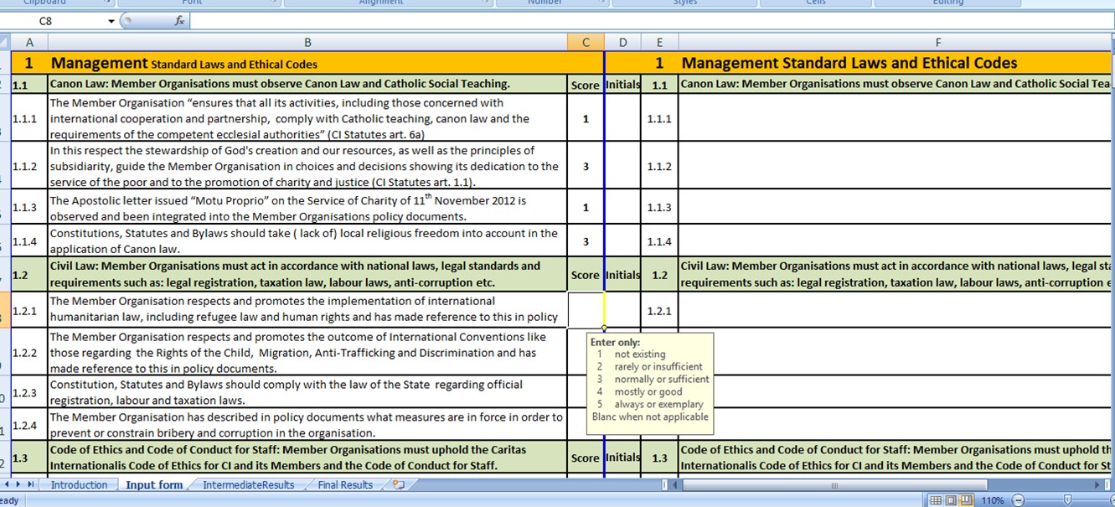
Tool for (self-)assessment: appendix 4
(Self-)assessment questionnaire
Notes:
See chapter 1 of the CIMS Coordinators manual for the process.
The tool is the self-assessment questionnaire, appendix 4.

Slide 14
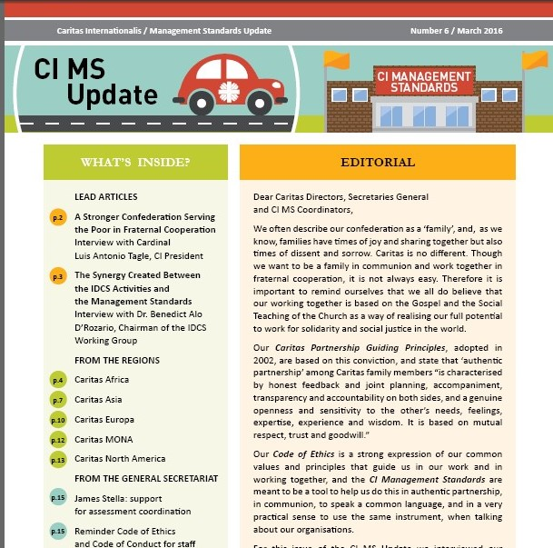
Communication
Notes:
Action plan: reg coord, staff meetings, CI MS coord – follow up, newsletter, design, visualization, fundraising
Survey for the newsletter

Slide 15
Good practice database: Baobab

Slide 16
Challenges
Challenges
Big and small organisations
Different cultural, political, ethical background (minority of Catholics)
Resistance of the organisation to change: commitment of the leadership
Motivation and time (resources) to commit to start implementing the standards
Non responsiveness of member organisations
Staff turnover in the organisation
CI MS self- assessment tool too long
Documents for assessments are to be received in different languages
Trying to be “the best” instead of taking slow steps
No certification in place
Keeping the deadline, 30 June, 2016
Notes:
Small Mos: Less than five full-time staff, less than € 500,000 over the last 3 years
Difference: The CIMS describe what you should do, not how to do it. The how is locally to be determined, with local law, customs and environment taken into account.
Challenges
Limited resource for doing on-site assessments
Sharing best practices

Slide 17
Keys to success…
ONE common tool:
all Members involved in the development of the standards
bringing (funding) partners together to use the same tool
Respecting the autonomy:
descriptive not prescriptive (what but not how) think global – act local
Mutual Confederation support: assessors, peer-to-peer support, sharing knowledge
PATIENCE! ☺
Notes:
The CI MS is respecting your autonomy: they describe what policies and procedures need to be in place in a well-functioning Caritas in this day and age. They describe what you should do, not how to do it. The how is locally to be determined, with local law, customs and environment taken into account. You are the driver of the car for which the CI MS provides the infrastructure for your continuous journey to professionalism. We provided tools to assist, other MOs on the road can and will assist and you as driver also determine the speed at which you can afford to travel. The CI MS are a comprehensive system and from the assessment you will have to determine the priorities and plan for further improvement.
Another important option we offer the Confederation is to share your existing written good practice in our BAOBAB database of good practice. Here we are building a Caritas library which facilitates other forms of learning, more direct and horizontal then bilateral assistance between two partners.

Slide 18
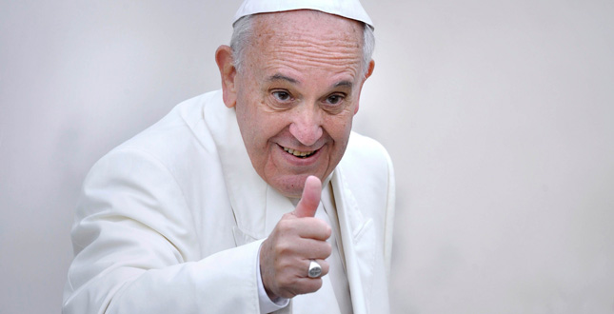
Message Pope Francis
“As I said at your last General Assembly, I thank the Lord for Caritas and its valuable service in the world. I also congratulate the Governance bodies and the General Secretariat of Caritas Internationalis for developing and approving the Management Standards and Code of Conduct for the member organizations.
These instruments must now be applied to strengthen the transparency and credibility of Caritas. Let us remember that we are accountable to God, to the Church, to the donors and in particular, to the poor with whom the Lord indentifies Himself. By serving them with humility, dedication, self-denial and professionalism, we promote the Church’s mission of forming one human family, caring for creation.”
Notes:
… message from the Holy Father.
It is a strong appeal to us as Caritas to continue on this road, which is in keeping with the Pope’s vision for the Church at large: to reach out to the poor and the marginalized and make sure that the administration and financial side of the church is being run in an honest and transparent manner, which gives us comfort that it is being controlled one way or another so that the money can go for the intended purpose.
<Message vizualisation in this slide to be replaced by ‘newsletter version’ – if ready on time>

