Slide 1
Patient Safety Global or Country Specific ?
David Marx

Slide 2
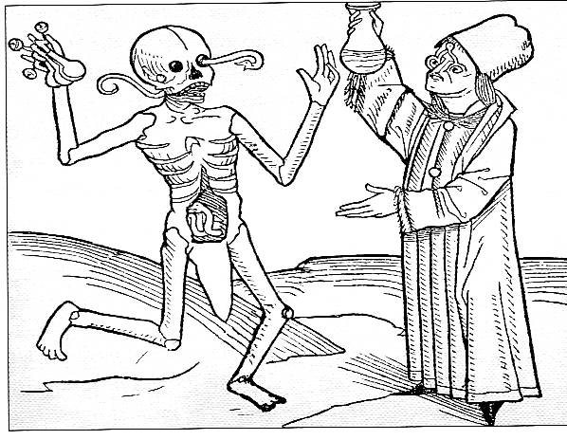

Slide 3
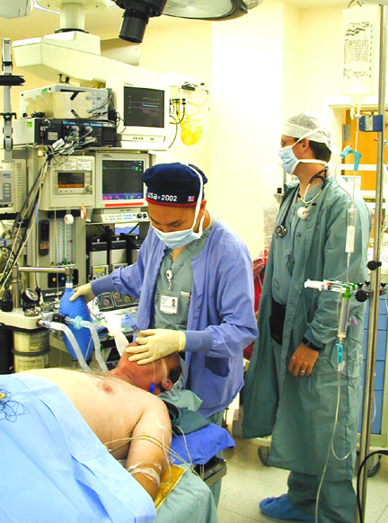
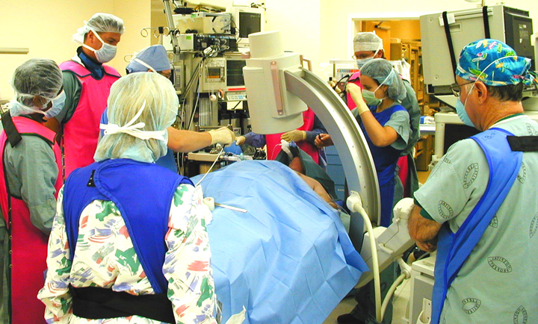
Notes:
The Institute of Medicine report reminds us that health care is probably the most complex of human endeavours!

Slide 4
Physician vs Patient
He will resemble God – savior of slaves, of rich and poor men and noblemen – to all he will be brother and protector…
(Asclepion)

Slide 5
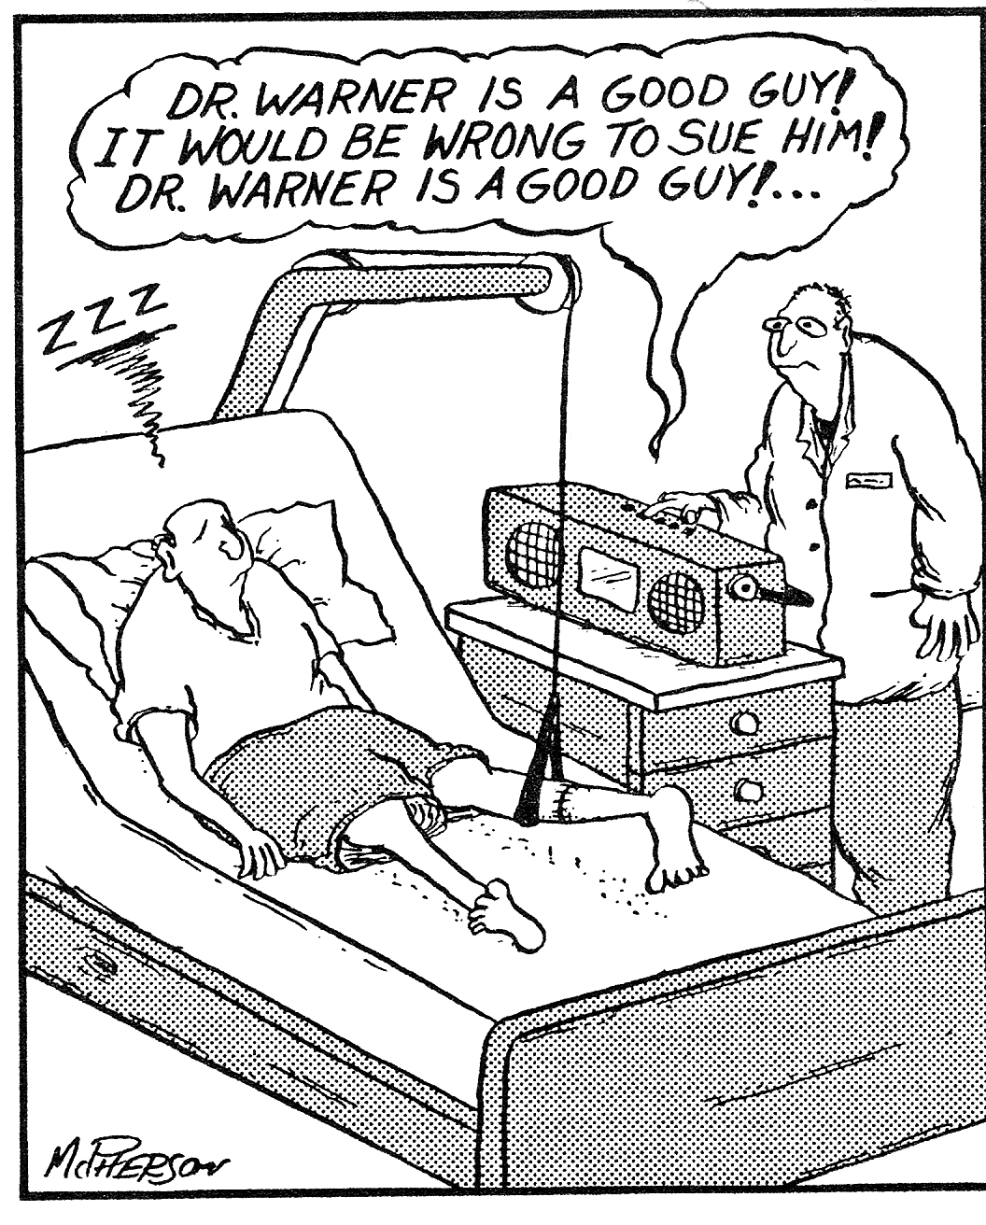

Slide 6
Danger of Health Care
Error problem
Notes:
This slide compares HC with other potentially hazardous activities and industries. It is exceedingly dangerous: comparable to mountain climbing in the risk of a fatality, and exceeding road traffic accidents in the number of people killed each year.

Slide 7
Medicine/Health Care
THEN
Simple
Non efficient
SAFE
NOW
Complicated
Highly efficient
RISKY

Slide 8
Patient Safety Activities
Council of Europe Declaration 1998
WHO Global Alliance for Patient Safety
EC Regulation - 2009

Slide 9
Patient Safety Goals/Solutions clinical
Identification problems
High risk medication
Wrong side/site/structure surgery prevention
Safe communication
Clean care – Safe care

Slide 10
Patient Safety Goals – Non Clinical
Security
Fire Safety
Staff privileges/competencies

Slide 11
Global/Local
General risks in Health Care are GLOBAL
Solutions are GLOBAL/LOCAL

Slide 12
Where does local resistance come from ?
Culture
Physician as a God or as a service provider ?
Hierarchy
Role of “other” health care providers
Static/Dynamic competencies
Traditional role of patients
Local law
Patient rights
Openness of health care providers

Slide 13
How to deal with resistance ?
National Patient Safety Policies
External Quality and Safety Control
Role of Payers
Education
Role of Patients

Slide 14
Most frequent areas of resistance
Patient rights
Rights of specific populations
Team members position
Individual privileges of physicians
Primary source verification

Slide 15
Challenges
Education
Audit fatigue
Selection of criteria for different types of health-care providers
(Third party) Motivation for risk management

Slide 16
