Slide 1
Intercultural communication
Cross-cultural management
issues in contemporary Social
and Healthcare Services
Mari Kokkonen 23.5.2016

Slide 2
Finnish people waiting for a bus…

Slide 3
Definition of INTERCULTURAL COMMUNICATION
”Communication is the act of transmitting messages, including information about the nature of the relationship, to another person who interprets these messages and gives them meaning” Berlo 1960
Communication process involves
the meaning that is to be transmitted,
the sender of the message,
a channel through which the message is
transmitted
the receiver of the message
Intercultural communication refers to exchanging information between people from different cultures
Cultural Field
Sender
Cultural Field
Receiver
Channel
MESSAGE
MESSAGE

Slide 4
Intercultural communication is more demanding, because..
Culturally different individuals have less common information and grounding due to their differences in their fields of expertise
Cultural fields:
Refer to elements of a person’s background
Education , values, attitudes
The particular filter through which the messages pass can lead to incomprehension of messages
Distortions and misunderstandings
Potential for inaccurate and incomplete information, even a total disruption of communication
Can lead to misunderstand the goal and interests of each other

Slide 5
Verbal communication
Language: the most obvious consideration in intercultural communication
Symbolic code of communication consisting of a set of sounds with understood meanings and set of rules for constructing messages
Using second language:
Causes cognitive strain and is exhausting
Fluency of second language is seen as competent in other respects
Modification by first-language speakers (slowing their speech and reducing sentence complexity)
Can be perceived as patronizing and might not be well received
Pretend to understand in order to avoid embarrassment or appear competent

Slide 7
Verbal communication:
Communication styles:
Present the values and norms that people have from their cultures
Often related to orientation of individualism and collectivism
How language is used for communication?
High-context style:
very little is in coded, explicit, transmitted part of the message
Implicit, words convey only a small part of the message
Low-context style:
The mass of the message is vested in the explicit code – words spoken
Directness: the extent to which communicators get to the point
Silence-tolerance
Use of praise and response to praise
Use of slang and jargon
Euphemisms, idioms, proverbs

Slide 9
Nonverbal communication
Convey important messages and are produced more automatically than words
Body movements and gestures, touching, facial expressions, and facial gazing, tone of voice, space usage, eye contact
Three aspects in nonverbal communication:
Nonverbal communication is unconscious
One should be aware of the impact of nonverbal commucation on others
Meaning assigned for nonverbal expression differs per culture
Within a culture, 70 % of communication is nonverbal
In intercultural encountering, nonverbal is even more important

Slide 11
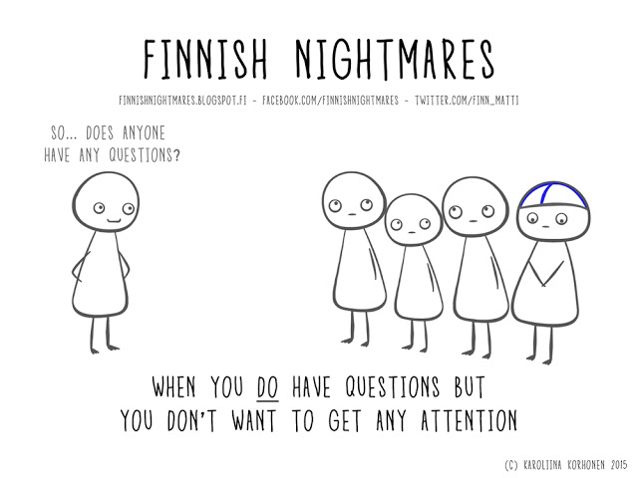
Any questions?

Slide 12
Literature
Aycan, Z., Kanungo, R. & Mendonca, M. 2014. Organization and management in cross-cultural context. London: Sage
Berlo, D.K. 1960. The process of communication. New York: Holt, Rinehart & Winston
Browaeys, M-J. & Price, R. 2015. Understanding cross-cultural management. Harlow: Pearson
Garten, F. 2015. The international manager. A guide for communication, cooperating and negotiating with worldwide colleagues. Baca Raton: CRC Press
Hofstede, G. 1980. Culture’s consequences: International differences in work related values. Beverly Hills: Sage
Thomas, D. & Peterson, M. 2015. Cross-cultural management. Essential concepts. London: Sage
Finnish Nightmares - http://finnishnightmares.blogspot.fi

